Slide 1

UK Train Rides Dashboard
Data Trainers
Date: 16/5/2025
16/05/2025

Slide 2
Project Idea
Problem
Train passengers in the UK frequently face delays, cancellations, and inconsistent service quality.
These issues negatively impact passenger satisfaction and operational efficiency.
Without clear data insights, identifying root causes and performance patterns is challenging.
Solution
Developed an interactive Power BI dashboard analyzing 31,653 real-world train booking records.
Provides insights into ticket sales, peak travel times, delay patterns, refund trends, and passenger behavior.
Empowers decision-makers to improve service delivery and operational efficiency.
Unique Value
Transforms complex railway data into an intuitive, decision-focused dashboard.
Designed for both technical and non-technical users.
Addresses business pain points, reduces losses, and enhances customer satisfaction through evidence-based decisions.
16/05/2025

Slide 3
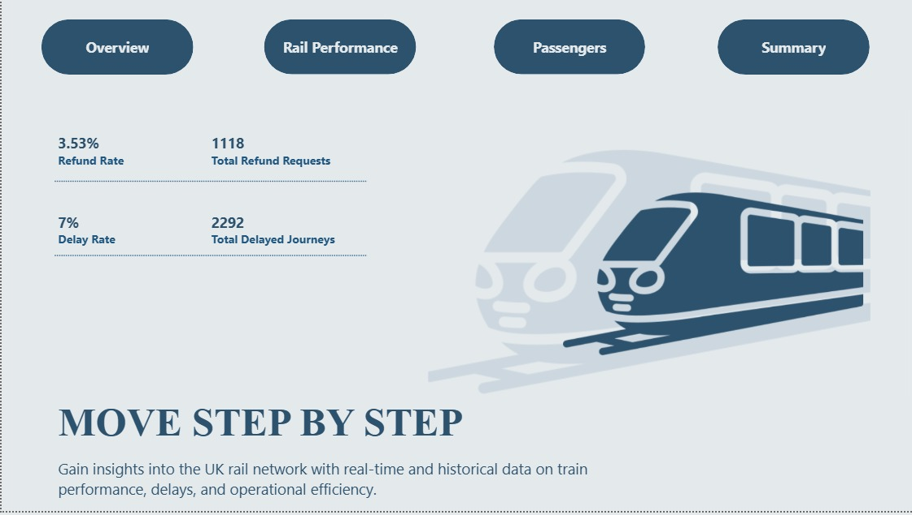
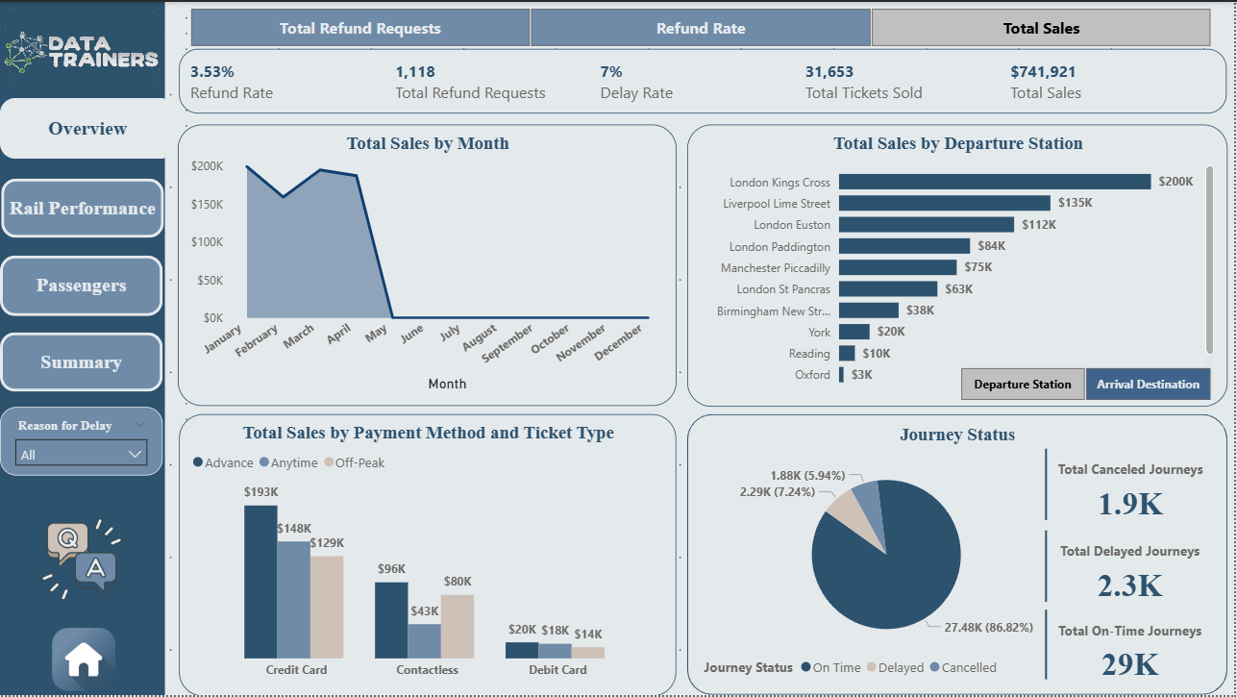
Dashboard
1. Home
2. Overview
16/05/2025

Slide 4
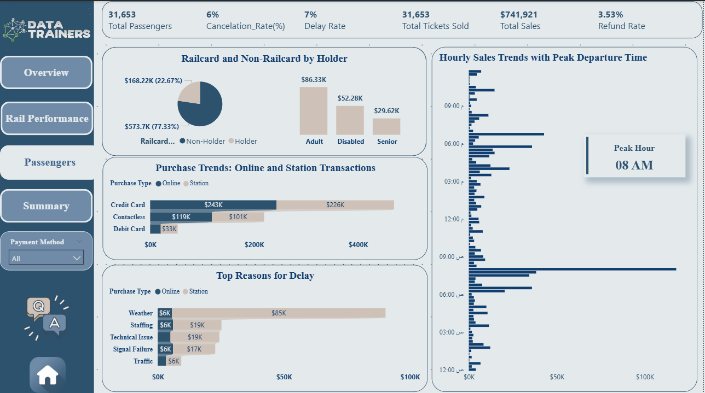
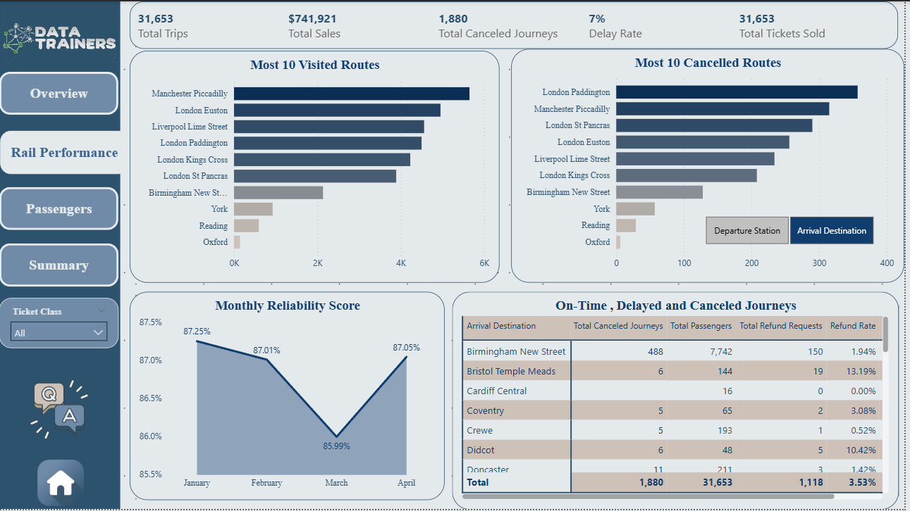
Dashboard
3. Passenger
4. Rail Performance
16/05/2025

Slide 5
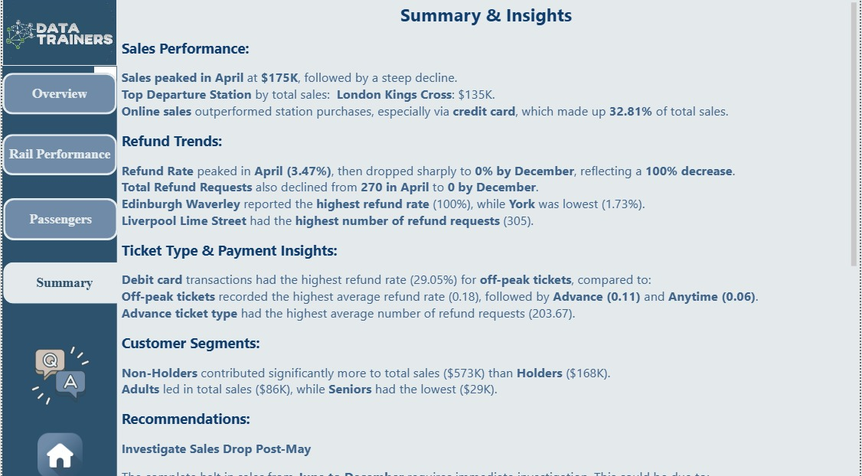
Insights
Sales Performance:
Sales peaked in Jan at $199K, followed by a steep decline.
Top Departure Station by total sales: London Kings Cross: $200K.
Online sales outperformed station purchases, especially via credit card, which made up 32.81% of total sales.
Refund Trends:
Refund Rate peaked in March (3.77%), then dropped sharply to 0% by December, reflecting a 100% decrease.
Total Refund Requests also declined from 306 in March to 0 by December.
Edinburgh Waverley reported the highest refund rate (100%), while York was lowest (1.73%).
Liverpool Lime Street had the highest number of refund requests (305).
Ticket Type & Payment Insights:
Debit card transactions had the highest refund rate (49.09%) for off-peak tickets, compared to:
Off-peak tickets recorded the highest average refund rate (0.18), followed by Advance (0.11) and Anytime (0.06).
Advance ticket type had the highest average number of refund requests (203.67).
Customer Segments:
Non-Holders contributed significantly more to total sales ($573K) than Holders ($168K).
Adults led in total sales ($86K), while Seniors had the lowest ($29K).
16/05/2025

Slide 6
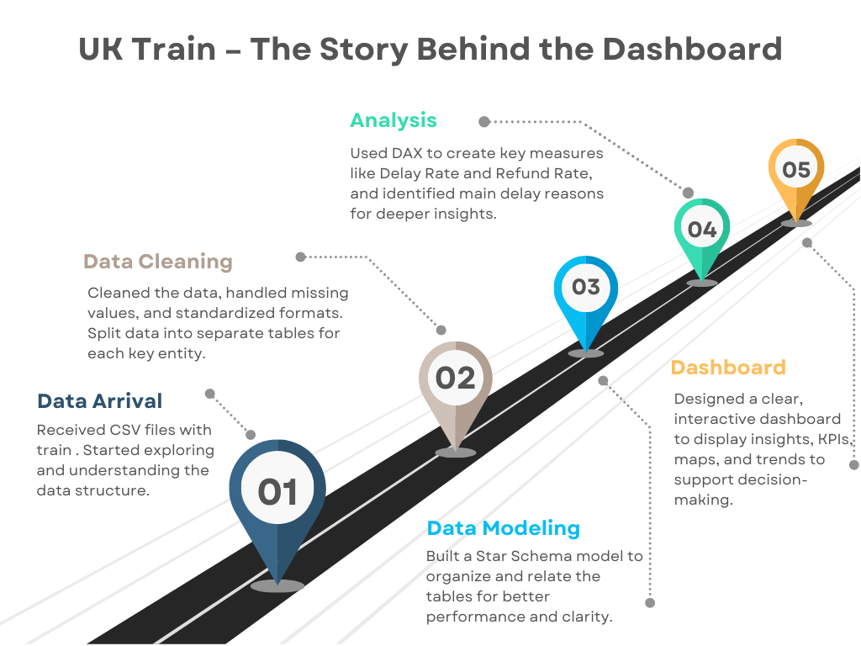
16/05/2025

Slide 7
Data Architecture & Processing Flow
Architecture
Flat-file CSV (non-relational), processed in Power BI.
Contains 31,653 ticket booking records.
Data Flow
Source: Raw CSV dataset
Cleaning: Handled in Power Query
Loading: Imported into Power BI
Transformation: Using DAX expressions & filters
Visualization: Built with interactive visuals and KPIs
Key Entities
Transaction: Each ticket booking and journey record (Fact_Transaction).
Railcard: Types of railcards and their holders (Dim_Railcard).
Stations: Details about departure and arrival stations (Dim_Departure, Dim_Arrival).
Delay: Reasons and durations of train delays (Dim_Delay).
Purchase: Methods and types of ticket purchases (Dim_Purchase).
Ticket: Ticket class and type information (Dim_Ticket).
Payment: Payment methods used by customers (Dim_Payment).
Date: Time and date attributes for analysis (Dim_Calendar).
16/05/2025

Slide 8
Project Wireframe
User Interface Design:
Homepage: Summary KPIs on revenue, ticket sales, delays.
Dashboard Pages: Delay analytics, refund requests, customer trends, route-level performance.
User Journey:
Login (optional for hosted report).
Select timeframe or filters (date, station, ticket type).
Interact with visualized data through maps, graphs, and tables.
Export or print summaries for stakeholder use.
16/05/2025

Slide 9
End Users & Features
User Personas
Operations Managers: Monitor train performance and delays to optimize schedules.
Customer Service Teams: Track refunds and satisfaction trends to enhance customer experience.
Sales & Marketing Analysts: Analyze purchasing behavior to optimize marketing efforts.
Executives: Gain a high-level overview of efficiency, revenue, and operational metrics.
How Features Solve Needs
Enables managers to reduce delays.
Helps service teams address refund spikes.
Allows analysts to improve promotional strategies.
Provides executives with clear KPIs for strategic decisions.
16/05/2025

Slide 10
Technologies & Tools Used
Tools & Platforms:
Microsoft Excel: Used for Exploratory Data Analysis (EDA) to understand the data structure, spot anomalies, and prepare fields.
Power Query Editor: Enabled efficient data cleaning, filtering, and transformation before modeling.
M Language (Power Query Formula Language): Applied in Power Query for transforming and shaping the raw CSV data into a structured format suitable for modeling.
Power BI Desktop: Core tool for creating the data model, implementing DAX logic, and designing the final dashboard.
DAX (Data Analysis Expressions): Used to calculate KPIs such as delay rates, refund rates, and other performance measures essential to the analysis.

Slide 11
Deliverables
Reports & Documentation
Power BI Dashboard: Interactive analysis of train ticket and travel data.
Project Presentation (PowerPoint): Full overview with visuals and insights.
Business Report (PDF/Word): Summarized analysis, KPIs, and recommendations.
Data Cleaning Documentation: Preprocessing steps with before/after examples.
Timeline
Week 1: Data understanding & cleaning.
Week 2: Data modeling & KPI identification.
Week 3: Dashboard creation (visuals, slicers, insights).
Week 4: Final documentation, testing, and presentation preparation.
Final Product
Fully working Power BI .pbix file.
Presentation file (.pptx).
Technical Report
16/05/2025

Slide 12
Project Team & Roles
Team Members
Moaz Adel Abdelsalam - Data Modeling & DAX: Creating data relationships, writing DAX measures, optimizing structure.
Roaa Mohamed Saad - Dashboard Development & Visualization: Designing visual layout, building charts, ensuring clarity.
Aya Osama Ramadan - Visualization & DAX: Supporting visuals, creating measures, aligning with business needs.
Marwan Walid AbdElmetaal - Business Analysis & Insights: Identifying business questions, deriving insights, presenting findings.
Hana Islam Saber Elmallah - Data Cleaning & Preprocessing (ETL): Handling missing data, formatting, transforming raw data.
Collaboration
Weekly meetings via Microsoft Teams.
16/05/2025

Slide 13
Thank You
We appreciate your time and attention.
Feel free to reach out for questions or feedback.
Contact
Email: moaazadel2002@gmail.com
16/05/2025

